Slide 1


<Name>
<Date>

Slide 2

Outline
Executive Summary
Introduction
Methodology
Results
Conclusion
Appendix

Slide 3
Executive Summary
Summary of methodologies
Data Collection through API
Data Collection with Web Scraping
Data Wrangling
Exploratory Data Analysis with SQL
Exploratory Data Analysis with Data Visualization
Interactive Visual Analytics with Folium
Machine Learning Prediction
Summary of all results
Exploratory Data Analysis result
Interactive analytics in screenshots
Predictive Analytics result

Slide 4
Introduction
Project background and context
SpaceX promotes Falcon 9 rocket launches on their website at a price of $62 million, significantly lower than other providers whose costs can go upwards of $165 million per launch. This cost advantage mainly stems from SpaceX's ability to reuse the first stage. Consequently, by predicting the first stage's successful landing, we can estimate the overall launch cost. This predictive insight can be valuable for competing companies looking to bid against SpaceX for a rocket launch contract. Our project aims to develop a machine learning pipeline that predicts the likelihood of a successful first stage landing.
Problems you want to find answers
What factors contribute to a successful rocket landing?
What is the interaction of multiple factors that influence the success rate of a rocket's safe landing.
The necessary operational conditions required to ensure a successful landing program.

Slide 5

Section 1

Slide 6
Methodology
Executive Summary
Data collection methodology:
Data was collected using SpaceX API and web scraping from Wikipedia.
Perform data wrangling
Describe how data was One-hot encoding was applied to categorical features
Perform exploratory data analysis (EDA) using visualization and SQL
Perform interactive visual analytics using Folium and Plotly Dash
Perform predictive analysis using classification models
How to build, tune, evaluate classification models

Slide 7
Data Collection
Describe how data sets were collected.
The process began with gathering data through a get request to the SpaceX API. Following this, we decoded the response content as a JSON utilizing the .json() function and transformed it into a structured pandas dataframe using .json_normalize(). Subsequently, we conducted data cleaning, addressing any missing values by appropriate filling. Additionally, we utilized web scraping techniques with BeautifulSoup on Wikipedia to extract Falcon 9 launch records from HTML tables. The aim was to parse and convert this table data into a pandas dataframe, preparing it for future analysis.

Slide 8
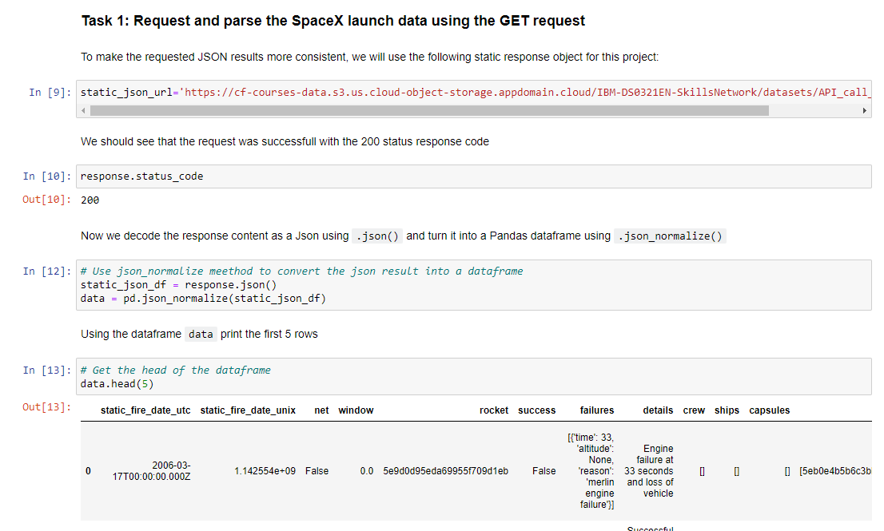
Data Collection – SpaceX API
We employed a get request to access data from the SpaceX API, followed by cleaning, basic data wrangling, and formatting of the retrieved information.
The Notebook link is: https://github.com/evanhrf/IBM_DS_Final_Project/blob/main/jupyter-labs-spacex-data-collection-api.ipynb

Slide 9
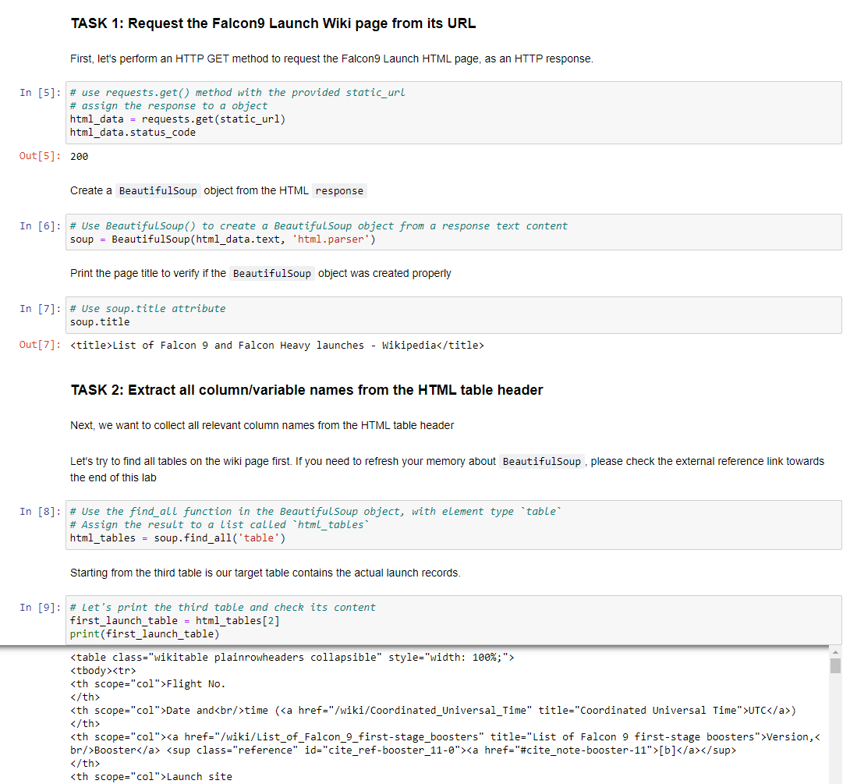
Data Collection - Scraping
We applied web scrapping to webscrap Falcon 9 launch records with BeautifulSoup
We parsed the table and converted it into a pandas dataframe.
The Notebook link is: https://github.com/evanhrf/IBM_DS_Final_Project/blob/main/jupyter-labs-webscraping.ipynb

Slide 10
Data Wrangling
We conducted an initial analysis of the data and established the training labels. This involved calculating the launch counts for each site and tracking the frequency of various orbits. Additionally, we derived landing outcome labels based on the outcome column and exported the summarized results to a CSV file.
The Notebook link is: https://github.com/evanhrf/IBM_DS_Final_Project/blob/main/labs-jupyter-spacex-data_wrangling_jupyterlite.jupyterlite.ipynb

Slide 11


EDA with Data Visualization
We examined the data by creating visual representations illustrating the connections between flight numbers and launch sites, payloads and launch sites, success rates associated with different orbit types, flight numbers and orbit types, as well as the annual trends in launch success.
The Notebook link is: https://github.com/evanhrf/IBM_DS_Final_Project/blob/main/jupyter-labs-eda-dataviz.ipynb.jupyterlite.ipynb

Slide 12
EDA with SQL
We loaded the SpaceX dataset into a PostgreSQL database without leaving the jupyter notebook.
We applied EDA with SQL to get insight from the data. We wrote queries to find out for instance:
The names of unique launch sites in the space mission.
The total payload mass carried by boosters launched by NASA (CRS)
The average payload mass carried by booster version F9 v1.1
The total number of successful and failure mission outcomes
The failed landing outcomes in drone ship, their booster version and launch site names.
The Notebook link is: https://github.com/evanhrf/IBM_DS_Final_Project/blob/main/jupyter-labs-eda-sql-coursera_sqllite.ipynb

Slide 13
Build an Interactive Map with Folium
We labeled all the launch locations and incorporated map elements like markers, circles, and lines on the Folium map to indicate the success or failure of launches for each site.
We designated the launch outcomes (failure or success) as features and assigned them to respective classes: 0 for failure and 1 for success.
By analyzing marker clusters color-coded for success rates, we pinpointed launch sites with notably high success rates.
We computed the distances from a launch site to its nearby locations and addressed specific inquiries, such as:
Do launch sites keep certain distance away from cities.
Are launch sites near railways, highways and coastlines.
The Notebook link is: https://github.com/evanhrf/IBM_DS_Final_Project/blob/main/lab_jupyter_launch_site_location.jupyterlite.ipynb

Slide 14
Build a Dashboard with Plotly Dash
We built an interactive dashboard with Plotly dash
We plotted pie charts showing the total launches by a certain sites
We plotted scatter graph showing the relationship with Outcome and Payload Mass (Kg) for the different booster version.
The Notebook link is https://github.com/evanhrf/IBM_DS_Final_Project/blob/main/Dashboard%20Application%20with%20Plotly%20Dash.py

Slide 15
Predictive Analysis (Classification)
We loaded the data using numpy and pandas, transformed the data, split our data into training and testing.
We built different machine learning models and tune different hyperparameters using GridSearchCV.
We used accuracy as the metric for our model, improved the model using feature engineering and algorithm tuning.
We found the best performing classification model.
The link to the notebook is https://github.com/evanhrf/IBM_DS_Final_Project/blob/main/SpaceX_Machine_Learning_Prediction_Part_5.jupyterlite.ipynb

Slide 16
Results
Exploratory data analysis results
Interactive analytics demo in screenshots
Predictive analysis results

Slide 17

Section 2

Slide 18

Flight Number vs. Launch Site
Based on the plot, it became evident that a higher number of flights at a launch site correlated with an increased success rate.

Slide 19
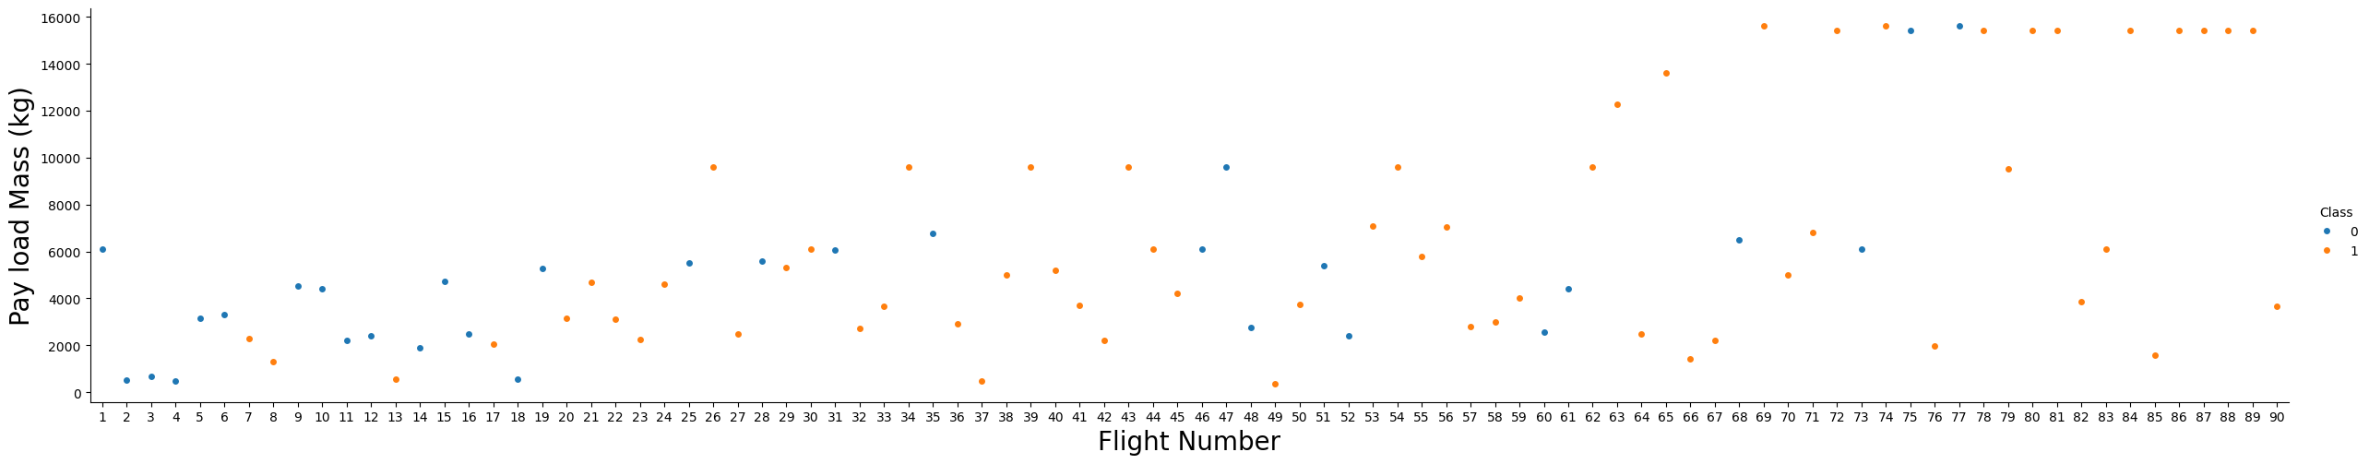
Payload vs. Launch Site
The greater the playload mass for launch site CCAFS SLC 40, the highrt the success rate for the rocket.

Slide 20

Success Rate vs. Orbit Type
From the plot, we can see that ES-L1, GEO, HEO, SSO, VLEO had the most success rate.

Slide 21
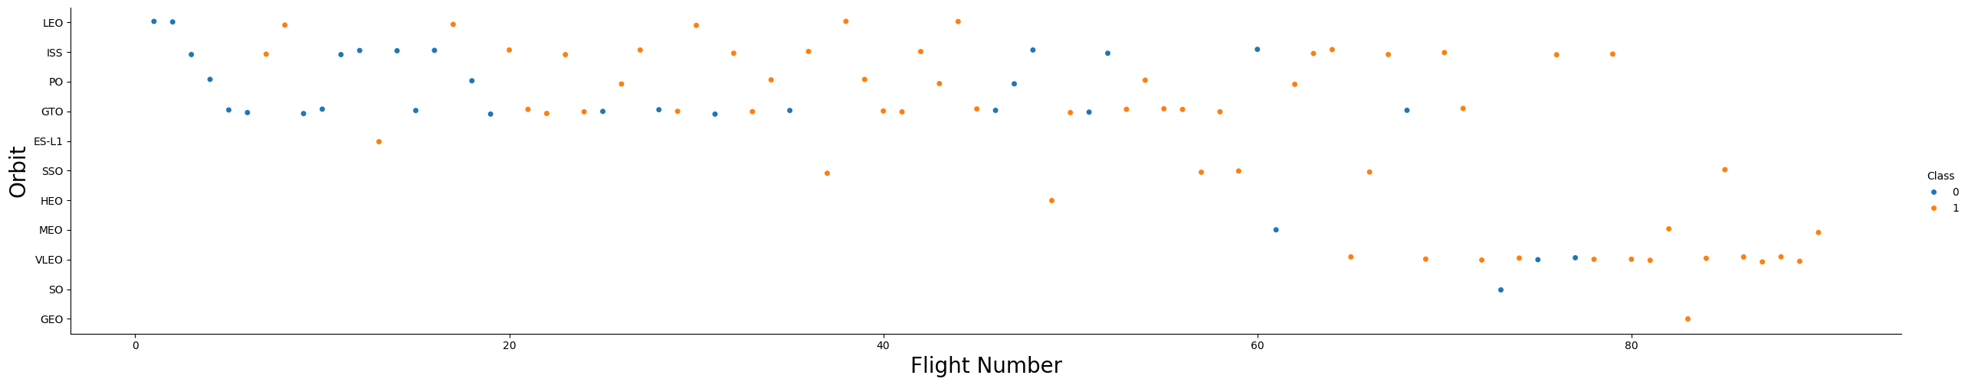
Flight Number vs. Orbit Type
The presented plot depicts the relationship between Flight Number and Orbit type. Our observation is that success in the LEO orbit is linked to the flight count, while in the GTO orbit, the flight number doesn't have a discernible impact on the orbit's success.

Slide 22
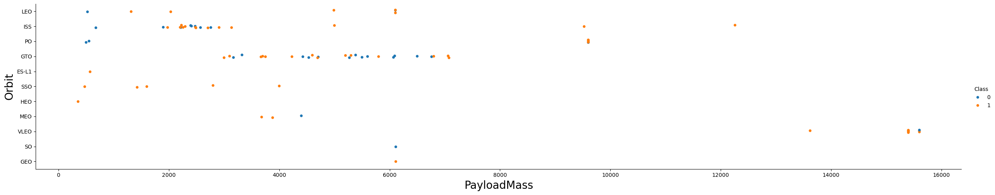
Payload vs. Orbit Type
It's noticeable that heavier payloads result in a higher frequency of successful landings for the PO, LEO, and ISS orbits.

Slide 23
Launch Success Yearly Trend
Based on the plot, it's evident that the success rate saw a continuous rise from 2013 until 2020.

Slide 24

All Launch Site Names
We utilized the term DISTINCT to display exclusive launch sites based on the SpaceX data.

Slide 25
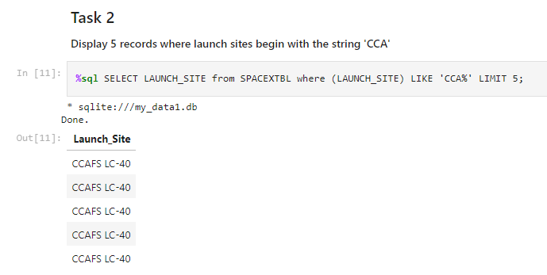
Launch Site Names Begin with 'CCA'
We employed the provided query to showcase five instances where the launch sites start with 'CCA'.

Slide 26
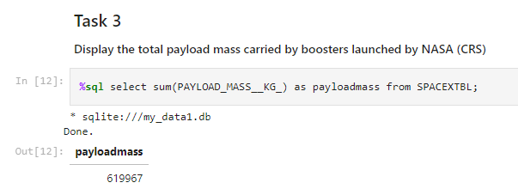
Total Payload Mass
Using the query below, we computed that the cumulative payload transported by NASA's boosters amounts to 619,967.

Slide 27
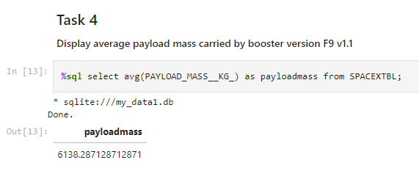
Average Payload Mass by F9 v1.1
We calculated the average payload mass carried by booster version F9 v1.1 as 6,138.3

Slide 28
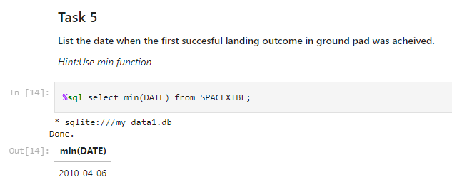
First Successful Ground Landing Date
We observed that the dates of the first successful landing outcome on ground pad was Apr 6, 2010

Slide 29

Successful Drone Ship Landing with Payload between 4000 and 6000
We employed the WHERE clause to narrow down boosters that achieved a successful landing on a drone ship. Additionally, we utilized the AND condition to identify successful landings with a payload mass ranging between 4000 and 6000.

Slide 30

Total Number of Successful and Failure Mission Outcomes
We utilized the wildcard symbol '%' to filter for cases where MissionOutcome indicated either success or failure in the WHERE clause.

Slide 31
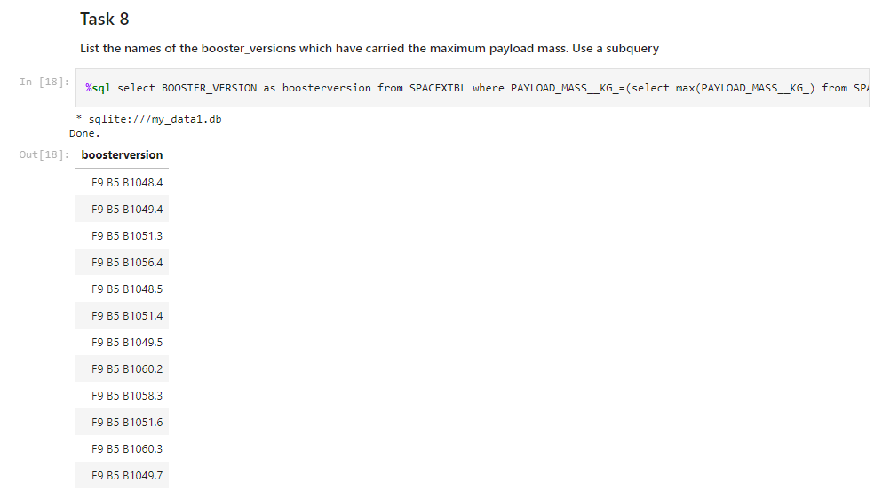
Boosters Carried Maximum Payload
We identified the booster that transported the highest payload by employing a subquery within the WHERE clause and utilizing the MAX() function.

Slide 32

2015 Launch Records
We utilized a combination of the WHERE clause, LIKE, AND, and BETWEEN conditions to filter out failed landings on drone ships, including their corresponding booster versions and launch site names for the year 2015.

Slide 33

Rank Landing Outcomes Between 2010-06-04 and 2017-03-20
We chose the landing outcomes and the count of these outcomes from the dataset, then employed the WHERE clause to narrow down the landing outcomes between June 4, 2010, and March 20, 2010.
We utilized the GROUP BY clause to categorize the landing outcomes and applied the ORDER BY clause to arrange the categorized landing outcomes in descending order.

Slide 34

Section 3

Slide 35
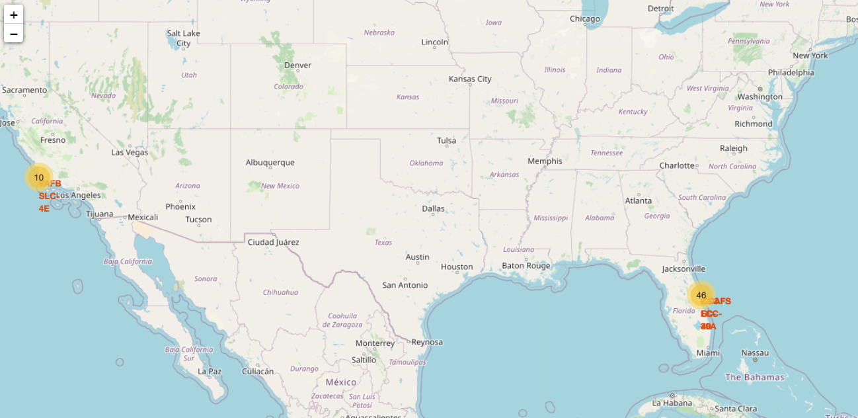
All launch sites global map markers
From the map, we can see the NASA launch sites

Slide 36

Markers showing launch sites with color labels

Slide 37

Launch Site distance to landmarks

Slide 38

Section 4

Slide 39

Pie chart showing the success percentage achieved by each launch site
Replace <Dashboard screenshot 1> title with an appropriate title
Show the screenshot of launch success count for all sites, in a piechart
Explain the important elements and findings on the screenshot

Slide 40

Pie chart showing the Launch site with the highest launch success ratio

Slide 41

Scatter plot depicting the relationship between Payload and Launch Outcome for all sites, with the ability to choose different payload ranges using a slider.

Slide 42

Section 5

Slide 43
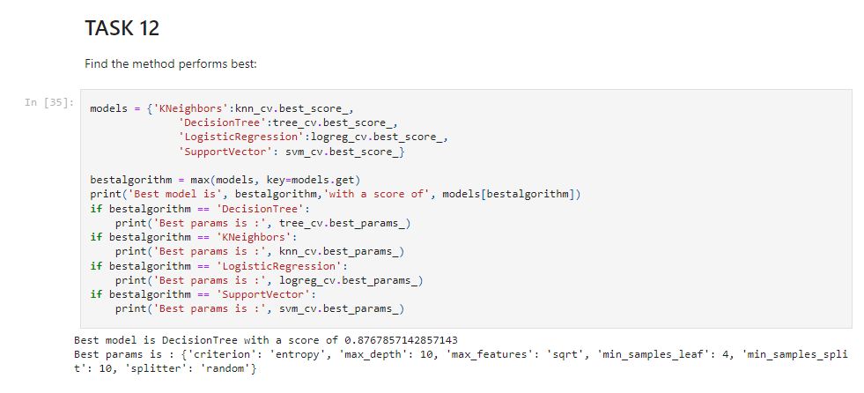
Classification Accuracy
The best model is the decision tree model with the greatest classification accuracy

Slide 44

Confusion Matrix
The confusion matrix of the decision tree classifier indicates its ability to differentiate between distinct classes. The primary concern lies in the occurrence of false positives, where unsuccessful landings are incorrectly identified as successful by the classifier.

Slide 45
Conclusions
The more flights there are at a launch site, the higher the likelihood of successful launches.
Between 2013 and 2020, the success rate of launches showed an upward trend.
Orbits such as ES-L1, GEO, HEO, SSO, and VLEO experienced the highest success rates.
Among the launch sites, KSC LC-39A stood out with the highest number of successful launches.
For this task, the most effective machine learning algorithm is the Decision Tree Classifier.

Slide 46


